Slide 1
ARTIFICIAL INTELLIGENCE
Dr T V RAJINI KANTH
PROFESSOR & DEAN R&D
SNIST

Slide 2
UNIT-I
Introduction to AI
Intelligent Agents
Problem-Solving Agents
Searching for Solutions
Breadth-first search
Depth-first search
Hill-climbing search
Simulated annealing search
Local Search in Continuous Spaces

Slide 3
RESOURCES
TEXT BOOKS:
1. Artificial Intelligence A Modern Approach, Third Edition, Stuart Russell and Peter Norvig, Pearson Education.
REFERENCES:
Artificial Intelligence, 3rd Edn., E. Rich and K. Knight(TMH)
Artificial Intelligence, 3rd Edn., Patrick Henny Winston, Pearson Education.
Artificial Intelligence, Shivani Goel, Pearson Education.
Artificial Intelligence and Expert systems – Patterson, Pearson Education.

Slide 4
Introduction to AI
Prerequisites:
programming in languages C (or C++) or Java or Python or Perl
knowledge of algorithmic concepts such as time complexities of algorithms; having some rough idea of what NP-hard means
Familiarity with probability
Not scared of mathematics, some background in discrete mathematics, able to do simple mathematical proofs

Slide 5
What is artificial intelligence?
Popular conception driven by science ficition
Robots good at everything except emotions, empathy, appreciation of art, culture, …
… until later in the movie.
Perhaps more representative of human autism than of (current) real robotics/AI
“It is my belief that the existence of autism has contributed to [the theme of the intelligent but soulless automaton] in no small way.” [Uta Frith, “Autism”]
Current AI is also bad at lots of simpler stuff!
There is a lot of AI work on thinking about what other agents are thinking

Slide 6
Real AI
A serious science.
General-purpose AI like the robots of science fiction is incredibly hard
Human brain appears to have lots of special and general functions, integrated in some amazing way that we really do not understand at all (yet)
Special-purpose AI is more doable (nontrivial)
E.g., chess/poker playing programs, logistics planning, automated translation, voice recognition, web search, data mining, medical diagnosis, keeping a car on the road, … … … …

Slide 7
Definitions of AI
if our system can be more rational than humans in some cases, why not?
Systems that think like humans | Systems that think rationally
Systems that act like humans | Systems that act rationally
focus on action avoids philosophical issues such as “is the system conscious” etc.
We will follow “act rationally” approach
Distinction may not be that important
acting rationally/like a human presumably requires (some sort of) thinking rationally/like a human,
humans much more rational anyway in complex domains

Slide 8
INTRODUCTION
Homo sapiens—man the wise—because our intelligence is so important to us.
AI is one of the newest fields in science and engineering
AI consists of variety of subfields, ranging from the general (learning and perception) to the specific, such as playing chess, proving mathematical theorems, writing poetry, driving a car on a crowded street, and diagnosing diseases.
AI is relevant to any intellectual task; it is truly a universal field.
Intelligence: “ability to learn, understand and think” (Oxford dictionary)
AI is the study of how to make computers make things which at the moment people do better.
Examples: Speech recognition, Smell, Face, Object, Intuition, Inferencing, Learning new skills, Decision making, Abstract thinking.

Slide 9
AI prehistory
Philosophy Logic, methods of reasoning, mind as physical system foundations of learning, language, rationality
Mathematics Formal representation and proof algorithms, computation, (un)decidability, (in)tractability, probability
Economics utility, decision theory
Neuroscience physical substrate for mental activity
Psychology phenomena of perception and motor control, experimental techniques
Computer building fast computers engineering
Control theory design systems that maximize an objective function over time
Linguistics knowledge representation, grammar

Slide 10
Abridged history of AI
1943 McCulloch & Pitts: Boolean circuit model of brain
1950 Turing's "Computing Machinery and Intelligence"
1956 Dartmouth meeting: "Artificial Intelligence" adopted
1952—69 Look, Ma, no hands!
1950s Early AI programs, including Samuel's checkers program, Newell & Simon's Logic Theorist, Gelernter's Geometry Engine
1965 Robinson's complete algorithm for logical reasoning
1966—73 AI discovers computational complexity Neural network research almost disappears
1969—79 Early development of knowledge-based systems
1980-- AI becomes an industry
1986-- Neural networks return to popularity
1987-- AI becomes a science
1995-- The emergence of intelligent agents

Slide 11
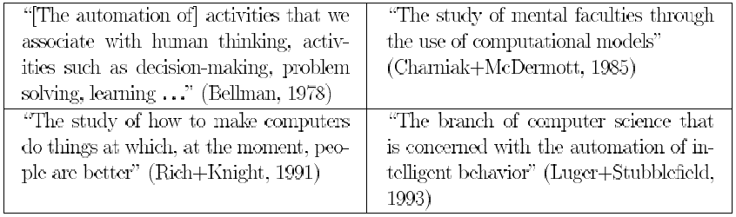
What is AI?
Historically, all four approaches to AI have been followed, each by different people with different methods. A rationalist approach involves a combination of mathematics and engineering.
Views of AI fall into four categories:
The textbook advocates "acting rationally”
Thinking humanly | Thinking rationally
Acting humanly | Acting rationally

Slide 12
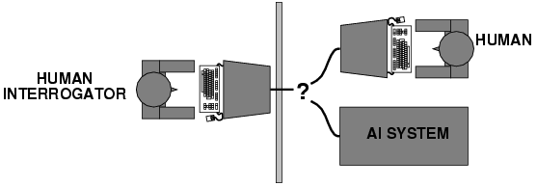
Acting humanly: Turing Test
Turing (1950) "Computing machinery and intelligence":
"Can machines think?" → "Can machines behave intelligently?"
Operational test for intelligent behavior: the Imitation Game
A Computer passes the test if a human interrogator, after posing some written questions, cannot tell whether the written responses come from a person or from a computer.
Predicted that by 2000, a machine might have a 30% chance of fooling a lay person for 5 minutes
Anticipated all major arguments against AI in following 50 years
Suggested major components of AI: knowledge, reasoning, language understanding, learning, computer vision, robotics

Slide 13
Thinking humanly: cognitive modeling
1960s "cognitive revolution": information-processing psychology Requires scientific theories of internal activities of the brain How to validate? Requires
1) Predicting and testing behavior of human subjects (top-down)
or
2) Direct identification from neurological data (bottom-up)
Both approaches (roughly Cognitive Science & Cognitive Neuroscience) are now distinct from AI
The interdisciplinary field of cognitive science brings together computer models from AI and experimental techniques from psychology to construct precise and testable theories of the human mind.
Three ways to do that a given program thinks like a human through - introspection - psychological experiments
- brain imaging

Slide 14
10 Exciting Applications of AI in Retail
1. McDonald’s Drive Through Smart Voice Assistant
2. H&M’s Assortment Planning using Artificial Intelligence
3.Pepper Robots, The New Choice of Nestlé to Sell Coffee Machines
4.Boch Automotive’s Artificial Intelligence Powered Sales Assistant
5. Mango and Vodafone’s Smart Digital Dressing Room
6. 53 Degrees North Applying Automated AI to the Process of Customer Segmentation
7. Domino’s Pizza-Lovers Now Get Hot Piping Pizza Delivered By a Pizza Robot
8. Nestlé’s AI Skill That Provides Voice Cooking Instructions As You Cook
9. Walmart Deploys Robots To Scan Shelves
10. Olay To Use AI To Personalize Skincare
REF: https://www.analyticsvidhya.com/blog/2019/12/10-exciting-real-world-applications-ai-retail/?utm_source=feedburner&utm_medium=email&utm_

Slide 15
AI APPLICATIONS
Robotic vehicles: A driverless robotic car named STANLEY sped through the rough terrain of the Mojave dessert at 22 mph, finishing the 132-mile course first to win the 2005 DARPA Grand Challenge. STANLEY is a Volkswagen Touareg outfitted with cameras, radar, and laser rangefinders to sense the environment and onboard software to command the steering, braking, and acceleration (Thrun, 2006).
Speech recognition: A traveler calling United Airlines to book a flight can have the entire conversation guided by an automated speech recognition and dialog management system.
Autonomous planning and scheduling: A hundred million miles from Earth, NASA’s REMOTE AGENT program became the first on-board autonomous planning program to control the scheduling of operations for a spacecraft (Jonsson et al., 2000). It generated plans from high-level goals specified from the ground and monitored the execution of those plans—detecting, diagnosing, and recovering from problems as they occurred. Successor program MAPGEN (Al-Chang et al., 2004) plans the daily operations for NASA’s Mars Exploration Rovers.

Slide 16
Game playing: IBM’s DEEP BLUE became the first computer program to defeat the world champion in a chess match when it bested Garry Kasparov by a score of 3.5 to 2.5 in an exhibition match (Goodman and Keene, 1997).
Spam fighting: Each day, learning algorithms classify over a billion messages as spam, saving the recipient from having to waste time deleting what, for many users, could comprise 80% or 90% of all messages, if not classified away by algorithms.
Logistics planning: During the Persian Gulf crisis of 1991, U.S. forces deployed a Dynamic Analysis and Replanning Tool, DART (Cross and Walker, 1994), to do automated logistics planning and scheduling for transportation. This involved up to 50,000 vehicles, cargo, and people at a time, and had to account for starting points, destinations, routes, and conflict resolution among all parameters.

Slide 17
Robotics: The iRobot Corporation has sold over two million Roomba robotic vacuum cleaners for home use. The company also deploys the more rugged PackBot to Iraq and Afghanistan, where it is used to handle hazardous materials, clear explosives, and identify the location of snipers.
Machine Translation: A computer program automatically translates from Arabic to English, allowing an English speaker to see the headline “Ardogan Confirms That Turkey Would Not Accept Any Pressure, Urging Them to Recognize Cyprus.” The program uses a statistical model built from examples of Arabic-to-English translations and from examples of English text totaling two trillion words (Brants et al., 2007).

Slide 18

1. McDonald’s Drive-Through Smart Voice Assistant
One of the world’s favorite restaurants moved quickly to transition into the AI era. One of the things I’ve found a bit tedious is the drive-through line, especially in the evening. I’m sure most of you have gone through this and sketched out your own plan to improve the waiting time. Well, artificial intelligence has solved that for us!
Our favorite burger chain has installed a voice-based platform for complex, multilingual, multi-accent and multi-item conversational ordering. It recently acquired an artificial intelligence company called APPRENTE, which has built this platform for them. Don’t you love the power of Natural Language Processing (NLP)
Think about it – the need for a smart voice assistant in this drive-through was quite obvious considering the time each customer typically takes to place a single order.

Slide 19
This makes the process of ordering faster and is cost-efficient as well – a win-win. This technology is “sound-to-meaning,” in contrast to “speech-to-text.”
Basically, the system does not transcribe what the customer says and then infer its meaning from that transcript. It goes directly from speech signals to result.
Now we will be talking to a robot about McFlurries – how exciting!
How about building a speech-to-text-model in Python on your own machine?

Slide 20


2. H&M’s Assortment Planning using Artificial Intelligence
The role of an apparel store owner is quite intensive. They have to plan for a new season and cautiously decide on what trends would the brand like to showcase to their customers. How to forecast fashion trends?
One approach is to track the past trends per season and then factor in the new styles (or fads). The brand can then make a decision based on these aspects.
Customers have a variety of tastes. Social media has changed the meaning of fashion – and apparel outlets, even the biggest brands in the world, are struggling to keep up.
So taking into account historical data to make a decision on the current scenario may be an obsolete approach.
This, as you might have guessed already, is where AI comes in.

Slide 21
AI algorithms can predict the most relevant items to add to a retailer’s inventory by analyzing the product assortments of competing brands and comparing those products to the demographics and shopping history of that customer.
H&M aims to forecast trends months in advance. The retail giant is employing over 200 data scientists, analysts and engineers to use AI to review purchasing patterns of every item in each store.
The data incorporates all the information from five billion footfalls from last year to its stores and traction on its websites. It also considers data from external sources.
BENEFITS:
The localization of inventory will suit the needs of its clients in every geographic area
Sharp data insights will help the brand eliminate bad product cycles
With RFID tech to its stores, there will be an improvement in its supply chain process

Slide 22

AI APPLICATIONS
REF: https://www.youtube.com/watch?v=AXgjEW2nA9I&feature=emb_logo

Slide 23
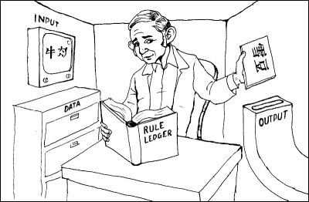
“Chinese room” argument [Searle 1980]
image from http://www.unc.edu/~prinz/pictures/c-room.gif
Person who knows English but not Chinese sits in room
Receives notes in Chinese
Has systematic English rule book for how to write new Chinese characters based on input Chinese characters, returns his notes
Person=CPU, rule book=AI program, really also need lots of paper (storage)
Has no understanding of what they mean
But from the outside, the room gives perfectly reasonable answers in Chinese!
Searle’s argument: the room has no intelligence in it!

Slide 24
Lessons from AI research
Clearly-defined tasks that we think require intelligence and education from humans tend to be doable for AI techniques
Playing chess, drawing logical inferences from clearly-stated facts, performing probability calculations in well-defined environments, …
Although, scalability can be a significant issue
Complex, messy, ambiguous tasks that come natural to humans (in some cases other animals) are much harder
Recognizing your grandmother in a crowd, drawing the right conclusion from an ungrammatical or ambiguous sentence, driving around the city, …
Humans better at coming up with reasonably good solutions in complex environments
Humans better at adapting/self-evaluation/creativity (“My usual strategy for chess is getting me into trouble against this person… Why? What else can I do?”)

Slide 25
Modern AI
More rigorous, scientific, formal/mathematical
Fewer grandiose promises
Divided into many subareas interested in particular aspects
More directly connected to “neighboring” disciplines
Theoretical computer science, statistics, economics, operations research, biology, psychology/neuroscience, …
Often leads to question “Is this really AI”?
Some senior AI researchers are calling for re-integration of all these topics, return to more grandiose goals of AI
Somewhat risky proposition for graduate students and junior faculty…

Slide 26
Thinking rationally: "laws of thought"
Aristotle: what are correct arguments/thought processes? Several Greek schools developed various forms of logic: notation and rules of derivation for thoughts; may or may not have proceeded to the idea of mechanization
His syllogisms provided patterns for argument structures that always yielded correct conclusions when given correct premises. Ex: “Socrates is a man; All men are mortal; therefore, Socrates is mortal.” These laws of thought were supposed to govern the operation of the mind; their study initiated the field called logic Direct line through mathematics and philosophy to modern AI
Problems:
Not all intelligent behavior is mediated by logical deliberation
What is the purpose of thinking? What thoughts should I have?
Notes:
A syllogism is a kind of logical argument that applies deductive reasoning to arrive at a conclusion based on two or more propositions that are asserted or assumed to be true.

Slide 27
Acting rationally: rational agent
An agent is just something that acts (agent comes from the Latin agere, to do).
A rational agent is one that acts so as to achieve the best outcome or, when there is uncertainty, the best expected outcome.
Rational behavior: doing the right thing
The right thing: that which is expected to maximize goal achievement, given the available information
Doesn't necessarily involve thinking – e.g., blinking reflex – but thinking should be in the service of rational action
Knowledge representation and Reasoning enable Agents to reach good decisions.
“laws of thought” approach to AI, emphasis was on correct inferences.
The standard of rationality is mathematically well defined and completely general, and can be “unpacked” to generate agent designs that provably achieve it.

Slide 28
Rational Agents
An agent is an entity that perceives and acts
This course is about designing rational agents
Abstractly, an agent is a function from percept histories to actions:
[f: P* → A]
For any given class of environments and tasks, we seek the agent (or class of agents) with the best performance
Caveat: computational limitations make perfect rationality unachievable
→ design best program for given machine resources

Slide 29
State of the Art
Deep Blue defeated the reigning world chess champion Garry Kasparov in 1997
Proved a mathematical conjecture (Robbins conjecture) unsolved for decades
No hands across America (driving autonomously 98% of the time from Pittsburgh to San Diego)
During the 1991 Gulf War, US forces deployed an AI logistics planning and scheduling program that involved up to 50,000 vehicles, cargo, and people
NASA's on-board autonomous planning program controlled the scheduling of operations for a spacecraft
Proverb solves crossword puzzles better than most humans
Notes:
In mathematics, a conjecture is a conclusion or a proposition which is suspected to be true due to preliminary supporting evidence, but for which no proof or disproof has yet been found.

Slide 30
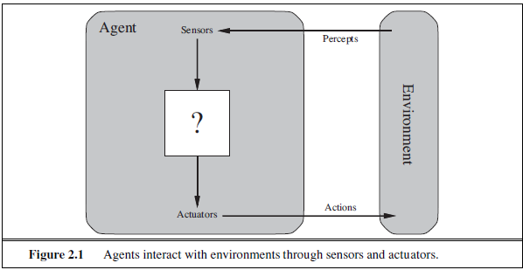
INTELLIGENT AGENTS
AGENTS AND ENVIRONMENTS
An Agent is anything that can be ENVIRONMENT viewed as perceiving its environment through sensors and SENSOR acting upon that environment through actuators.
Actuator: A device that causes a machine or other device to operate.

Slide 31
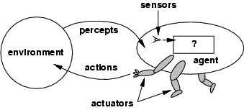
A Human Agent has eyes, ears, and other organs for sensors and hands, legs, vocal tract, and so on for actuators.
A Robotic Agent might have cameras and infrared range finders for sensors and various motors for actuators.
A Software Agent receives keystrokes, file contents, and network packets as sensory inputs and acts on the environment by displaying on the screen, writing files, and sending network packets.
Mathematically speaking an Agent’s behavior is described by the agent function that maps any given percept (interpret) sequence to an action
The agent function maps from percept histories to actions: [f: P* → A] agent program runs on the physical architecture to produce f; agent = architecture + program

Slide 32
Tabulating the Agent Function describes any given agent, construct this table by trying out all possible percept sequences and recording which actions the agent does in response.
Table is an external characterization of the agent and Internally, agent function for an artificial agent will be implemented by an agent program.
Agent function is an abstract mathematical description
Ex: vacuum-cleaner Agent world shown in Figure 2.2. This world is so simple that we can describe everything that happens; world has just two locations: squares A and B.
It can choose to move left, move right, suck up the dirt, or do nothing.
An Agent is meant to be a tool for analyzing systems, not an absolute characterization that divides the world into agents and non-agents.

Slide 33
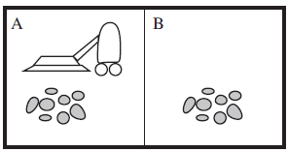
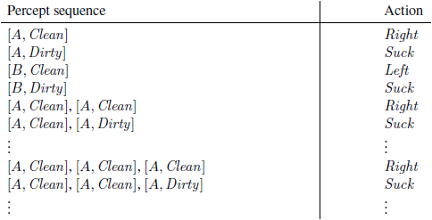
Figure 2.2 A vacuum-cleaner world with just two locations.
Figure 2.3 Partial tabulation of a simple agent function for the vacuum-cleaner world shown in Figure 2.2.
Ex: Hand-held calculator as an agent that chooses the action of displaying “4” when given the percept sequence 2 + 2 =
such an analysis would hardly aid our understanding of the calculator.

Slide 34
GOOD BEHAVIOR: THE CONCEPT OF RATIONALITY
Rational Agent:
It is one that does the right thing - conceptually speaking, every entry in the table for the agent function is filled out correctly.
An agent should strive to "do the right thing", based on what it can perceive and the actions it can perform. The right action is the one that will cause the agent to be most successful
Performance measure: An objective criterion for success of an agent's behavior
Ex: Performance measure of a vacuum-cleaner agent could be amount of dirt cleaned up, amount of time taken, amount of electricity consumed, amount of noise generated, etc.

Slide 35
Rationality
What is rational at any given time depends on four things:
• The performance measure that defines the criterion of success.
• The agent’s prior knowledge of the environment.
• The actions that the agent can perform.
• The agent’s percept sequence to date.
Rational Agent: For each possible percept sequence, a rational agent should select an action that is expected to maximize its performance measure, given the evidence provided by the percept sequence and whatever built-in knowledge the agent has.
Rationality is distinct from omniscience (all-knowing with infinite knowledge)
Agents can perform actions in order to modify future percepts so as to obtain useful information (information gathering, exploration)

Slide 36
An agent is autonomous if its behavior is determined by its own experience (with ability to learn and adapt)
As a general rule, it is better to design performance measures according to what one actually wants in the environment, rather than according to how one thinks the agent should behave.
An omniscient agent knows the actual outcome of its actions and can act accordingly; but omniscience is impossible in reality.
THE NATURE OF ENVIRONMENTS
Think about task environments, which are essentially the “problems” to which rational agents are the “solutions.”
Specifying the task environment:
Rationality of the simple vacuum-cleaner agent, we had to specify the performance measure, the environment, and the agent’s actuators and sensors. We group all these under the heading of the task environment.

Slide 37
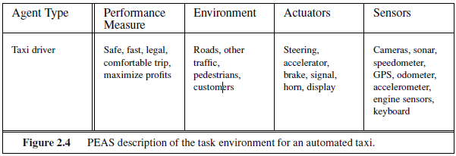
PEAS (PERFORMANCE, ENVIRONMENT, ACTUATORS, SENSORS) DESCRIPTION
The vacuum world was a simple example; let us consider a more complex problem: an automated taxi driver. A fully automated taxi is currently somewhat beyond the capabilities of existing technology.
The full driving task is extremely open-ended.

Slide 38
THE STRUCTURE OF AGENTS
The job of AI is to design an agent program that implements the agent function— the mapping from percepts to actions. We assume this program will run on some sort of computing device with physical sensors and actuators—we call this the architecture:
agent = architecture + program .
If the program is going to recommend actions like Walk, the architecture had better have legs.
The architecture might be just an ordinary PC, or it might be a robotic car with several onboard computers, cameras, and other sensors.
Architecture makes the percepts from the sensors available to the program, runs the program, and feeds the program’s action choices to the actuators as they are generated.

Slide 39
Agent programs
Agent programs take the current percept as input from the sensors and return an action to the actuators.
Difference between the agent program, which takes the current percept as input, and the agent function, which takes the entire percept history.
The agent program takes just the current percept as input because nothing more is available from the environment;
if the agent’s actions need to depend on the entire percept sequence, the agent will have to remember the percepts.

Slide 40
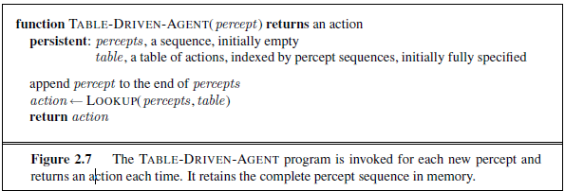
For example, Figure 2.7 shows a rather trivial agent program that keeps track of the percept sequence and then uses it to index into a table of actions to decide what to do.
The table—an example of which is given for the vacuum world in Figure 2.3—represents explicitly the agent function that the agent program embodies.
To build a rational agent in this way, as a designers must construct a table that contains the appropriate action for every possible percept sequence.

Slide 41
It is instructive to consider why the table-driven approach to agent construction is doomed to failure.
Let P be the set of possible percepts and let T be the lifetime of theagent (the total number of percepts it will receive).
The lookup table will contain entries.
Consider the automated taxi: the visual input from a single camera comes in at the rate of roughly 27 megabytes per second (30 frames per second, 640×480 pixels with 24 bits of color information).
This gives a lookup table with over 10^{250,000,000,000} entries for an hour’s driving. Even the lookup table for chess—a tiny, well-behaved fragment of the real world—would have at least 10150 entries.

Slide 42
The daunting size of these tables means that
(a) no physical agent in this universe will have the space to store the table
(b) the designer would not have time to create the table
(c) no agent could ever learn all the right table entries from its experience, and
(d) even if the environment is simple enough to yield a feasible table size, the designer still has no guidance about how to fill in the table entries
TABLE-DRIVEN-AGENT does do what we want: it implements the desired agent function.
The key challenge for AI is to find out how to write programs that, to the extent possible, produce rational behavior from a smallish program rather than from a vast table.

Slide 43
For ex: Huge tables of square roots used by engineers and schoolchildren prior to the 1970s have now been replaced by a five-line program for Newton’s method running on electronic calculators.
The question is, can AI do for general intelligent behavior what Newton did for square roots? We believe the answer is yes.
Table-lookup agent
\input{algorithms/table-agent-algorithm}
Drawbacks:
Huge table
Take a long time to build the table
No autonomy
Even with learning, need a long time to learn the table entries

Slide 44
Four basic kinds of agent programs that embody the principles underlying almost all intelligent systems:
• Simple reflex agents;
• Model-based reflex agents;
• Goal-based agents; and
• Utility-based agents.
Each kind of agent program combines particular components in particular ways to generate actions
Explains in general terms how to convert all these agents into learning agents that can improve the performance of their components so as to generate better actions.
Simple reflex agents
The simplest kind of agent is the simple reflex agent.
These agents select actions on the basis of the current percept, ignoring the rest of the percept history.

Slide 45
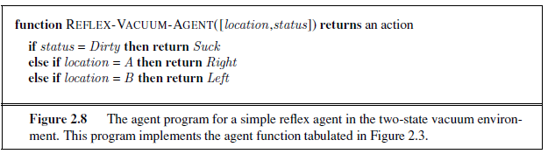
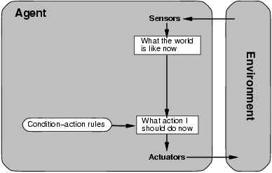
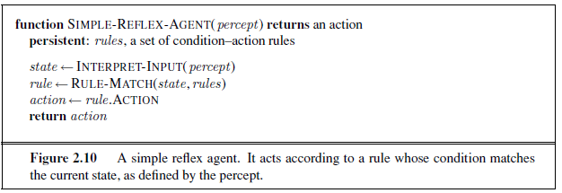
Simple reflex agents
Ex: the vacuum agent whose agent function is tabulated in Figure 2.3 is a simple reflex agent, because its decision is based only on the current location and on whether that location contains dirt. An agent program for this agent is shown in Figure 2.8.

Slide 46
Simple reflex behaviors occur even in more complex environments.
Imagine yourself as the driver of the automated taxi.
If the car in front brakes and its brake lights come on, then you should notice this and initiate braking.
Some processing is done on the visual input to establish the condition we call “The car in front is braking.”
Triggers some established connection in the agent program to the action “initiate braking.”
Call such a connection a condition–action rule, written as
if car-in-front-is-braking then initiate-braking
Humans also have many such connections, some of which are learned responses (as for driving) and some of which are innate reflexes (such as blinking when something approaches the eye)
Build a general-purpose interpreter for condition– action rules and then to create rule sets for specific task environments.

Slide 47
Use rectangles to denote the current internal state of the agent’s decision process, and ovals to represent the background information used in the process.
The INTERPRET-INPUT function generates an abstracted description of the current state from the percept, and the RULE-MATCH function returns the first rule in the set of rules that matches the given state description.
Description in terms of “rules” and “matching” is purely conceptual; actual implementations can be as simple as a collection of logic gates implementing a Boolean circuit.
The agent in Fig 2.10 will work only if the correct decision can be made on the basis of only the current percept—that is, only if the environment is fully observable.
Even a little bit of un-observability can cause serious trouble.
Ex: Braking rule given earlier assumes that the condition car-in-front-is-braking can be determined from the current percept —a single frame of video.

Slide 48
This works if the car in front has a centrally mounted brake light.
Older models have different configurations of taillights, brake lights, and turn-signal lights, and it is not always possible to tell from a single image whether the car is braking.
A simple reflex agent driving behind such a car would either brake continuously and unnecessarily, or, worse, never brake at all.
Infinite loops are often unavoidable for simple reflex agents operating in partially observable environments. Escape from infinite loops is possible if the agent can randomize its actions.
Ex: if the vacuum agent perceives [Clean], it might flip a coin to choose between Left and Right .
It is easy to show that the agent will reach the other square in an average of two steps. Then, if that square is dirty, the agent will clean it and the task will be complete.
Hence, a randomized simple reflex agent might outperform a deterministic simple reflex agent.

Slide 49
Problem solving agents
“how an agent can find a sequence of actions that achieves its goals when no single action will do”
problem-solving agent is one kind of goal-based agent.
Problem-solving agents use atomic representations
Goal-based agents that use more advanced factored or structured representations are usually called planning agents
General-purpose search algorithms that can be used to solve these problems
Uninformed search algorithms—algorithms that are given no information about the problem other than its definition.
some of these algorithms can solve any solvable problem, none of them can do so efficiently.
Informed search algorithms, on the other hand, can do quite well given some guidance on where to look for solutions.

Slide 50
Limit ourselves to the simplest kind of task environment, for which the solution to a problem is always a fixed sequence of actions.
More general case—where the agent’s future actions may vary depending on future percepts.
It uses the concepts of asymptotic complexity (that is, O() notation) and NP-completeness.
PROBLEM-SOLVING AGENTS
Intelligent agents are supposed to maximize their performance measure.
Imagine an agent in the city of Arad, Romania, enjoying a touring holiday.
The agent’s performance measure contains many factors: it wants to improve its suntan, improve its Romanian, take in the sights, enjoy the nightlife (such as it is), avoid hangovers, and so on.
The decision problem is a complex one involving many tradeoffs and careful reading of guidebooks.

Slide 51
Now, suppose the agent has a nonrefundable ticket to fly out of Bucharest the following day.
In that case, it makes sense for the agent to adopt the goal of getting to Bucharest.
Courses of action that don’t reach Bucharest on time can be rejected.
Goals help organize behavior by limiting the objectives that the agent is trying to achieve.
Goal formulation, based on the current situation and the agent’s performance measure, is the first step in problem solving.
If it were to consider actions at the level of “move the left foot forward an inch” or “turn the steering wheel one degree left,” the agent would probably never find its way out of the parking lot, let alone to Bucharest, because at that level of detail there is too much uncertainty in the world and there would be too many steps in a solution.

Slide 52
Problem formulation is the process of deciding what actions and states to consider, given a goal.
Assume that the agent will consider actions at the level of driving from one major town to another.
Each state therefore corresponds to being in a particular town.
Our agent has now adopted the goal of driving to Bucharest and is considering where to go from Arad.
Three roads lead out of Arad, one toward Sibiu, one to Timisoara, and one to Zerind.
None of these achieves the goal, so unless the agent is familiar with the geography of Romania, it will not know which road to follow.
The agent will not know which of its possible actions is best, because it does not yet know enough about the state that results from taking each action.
If the agent has no additional information—i.e., if the environment is unknown then it is has no choice but to try one of the actions at random.

Slide 53
But suppose the agent has a map of Romania.
The point of a map is to provide the agent with information about the states it might get itself into and the actions it can take.
The agent can use this information to consider subsequent stages of a hypothetical journey via each of the three towns, trying to find a journey that eventually gets to Bucharest.
Once it has found a path on the map from Arad to Bucharest, it can achieve its goal by carrying out the driving actions.
An agent with several immediate options of unknown value can decide what to do by first examining future actions that eventually lead to states of known value.
Assume that the environment is observable, so the agent always knows the current state.
Agent driving in Romania, it’s reasonable to suppose that each city on the map has a sign indicating its presence to arriving drivers.
Assume the environment is discrete, so at any given state there are only finitely many actions to choose from.

Slide 54
This is true for navigating in Romania because each city is connected to a small number of other cities.
We will assume the environment is known, so the agent knows which states are reached by each action.
Finally, we assume that the environment is deterministic, so each action has exactly one outcome. Under ideal conditions, this is true for the agent in Romania—it means that if it chooses to drive from Arad to Sibiu, it does end up in Sibiu.
Under these assumptions, the solution to any problem is a fixed sequence of actions.
Well, in general it could be a branching strategy that recommends different actions in the future depending on what percepts arrive.
Ex: Under less than ideal conditions, the agent might plan to drive from Arad to Sibiu and then to Rimnicu Vilcea but may also need to have a contingency plan in case it arrives by accident in Zerind instead of Sibiu.

Slide 55
Fortunately, if the agent knows the initial state and the environment is known and deterministic, it knows exactly where it will be after the first action and what it will perceive.
Since only one percept is possible after the first action, the solution can specify only one possible second action, and so on.
The process SEARCH of looking for a sequence of actions that reaches the goal is called search.
A search algorithm takes a problem as input and returns a solution in the form of an action sequence.
Once a solution is found, the actions it recommends can be carried out.
This is called the execution phase.
Thus, we have a simple “formulate, search, execute” design for the agent, as shown in Figure 3.1.

Slide 56
After formulating a goal and a problem to solve, the agent calls a search procedure to solve it.
It then uses the solution to guide its actions, Once the solution has been executed, the agent will formulate a new goal.
Notice that while the agent is executing the solution sequence it ignores its percepts when choosing an action because it knows in advance what they will be.
An agent that carries out its plans with its eyes closed, so to speak, must be quite certain of what is going OPEN-LOOP on.
Control theorists call this an open-loop system, because ignoring the percepts breaks the loop between agent and environment.

Slide 57
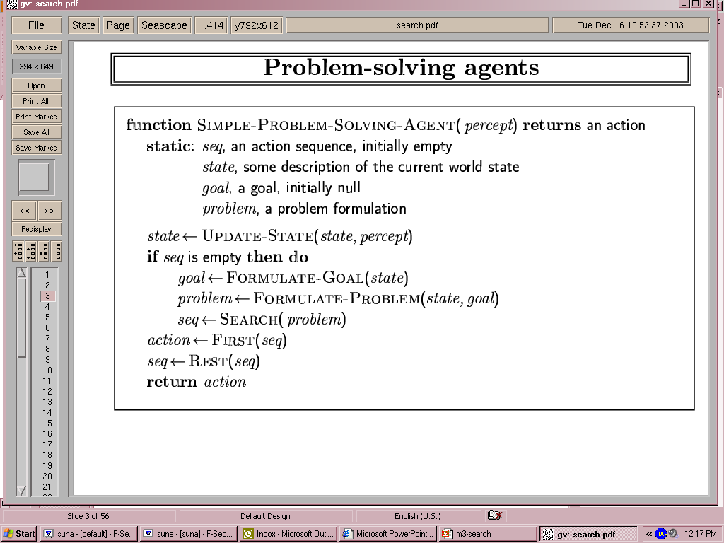
Problem-solving agents
Figure 3.1 A simple problem-solving agent. It first formulates a goal and a problem,
searches for a sequence of actions that would solve the problem, and then executes the actions one at a time. When this is complete, it formulates another goal and starts over.

Slide 58
Example: Romania
On holiday in Romania; currently in Arad.
Flight leaves tomorrow from Bucharest
Formulate goal:
be in Bucharest
Formulate problem:
states: various cities
actions: drive between cities
Find solution:
sequence of cities, e.g., Arad, Sibiu, Fagaras, Bucharest

Slide 59
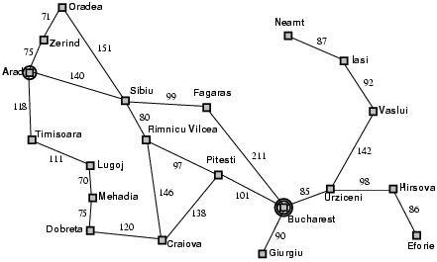
Example: Romania
Figure 3.2 A simplified road map of part of Romania.

Slide 60
8-queens problem
The goal of the 8-queens problem is to place eight queens on a chessboard such that no queen attacks any other.
(A queen attacks any piece in the same row, column or diagonal.)
Figure 3.5 shows an attempted solution that fails: the queen in the rightmost column is attacked by the queen at the top left.
There are two main kinds of formulation.
An incremental formulation involves operators that augment the state description, starting with an empty state; for the 8-queens problem, this means that each action adds a queen to the state.
A complete-state formulation starts with all 8 queens on the board and moves them around. In either case, the path cost is of no interest because only the final state counts.

Slide 61
The first incremental formulation is the following:
• States: Any arrangement of 0 to 8 queens on the board is a state.
• Initial state: No queens on the board.
• Actions: Add a queen to any empty square.
• Transition model: Returns the board with a queen added to the specified square.
• Goal test: 8 queens are on the board, none attacked.
This formulation has 64 ・ 63 ・ ・ ・ 57 ≈ 1.8×1014 possible sequences to investigate. Prohibit placing a queen in any square that is already attacked:
• States: All possible arrangements of n queens (0 ≤ n ≤ 8), one per column in the leftmost n columns, with no queen attacking another.
• Actions: Add a queen to any square in the leftmost empty column such that it is not attacked by any other queen.

Slide 62
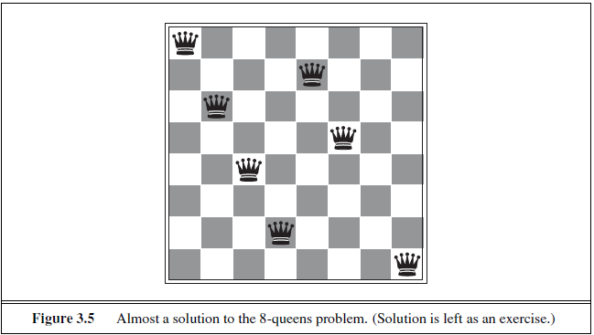
This formulation reduces the 8-queens state space from 1.8×1014 to just 2,057, and solutions are easy to find.
For 100 queens the reduction is from roughly 10400 states to about 1052 states a big improvement, but not enough to make the problem tractable.

Slide 63
SEARCHING FOR SOLUTIONS
A solution is an action sequence, so search algorithms work by considering various possible action sequences.
The possible action sequences starting at the initial state form a search tree with the initial state at the root; the branches are actions and the nodes correspond to states in the state space of the problem.
Figure 3.6 shows the first few steps in growing the search tree for finding a route from Arad to Bucharest.
The root node of the tree corresponds to the initial state, In(Arad).
The first step is to test whether this is a goal state.
Expanding the current state; that is, applying each legal action to the current state, thereby generating a new set of states.
Add three branches from the parent node In(Arad) leading to three new child nodes: In(Sibiu), In(Timisoara), and In(Zerind).
choose which of these three possibilities to consider further.

Slide 64
This is the essence of search—following up one option now and putting the others aside for later, in case the first choice does not lead to a solution.
Suppose we choose Sibiu first.
Check to see whether it is a goal state (it is not) and then expand it to get In(Arad), In(Fagaras), In(Oradea), and In(RimnicuVilcea).
Choose any of these four or go back and choose Timisoara or Zerind.
Each of these six nodes is a leaf node, that is, a node with no children in the tree.
The set of all leaf nodes available for expansion at any given point is called the frontier.
In Fig 3.6, the frontier of each tree consists of those nodes with bold outlines.
The process of expanding nodes on the frontier continues until either a solution is found or there are no more states to expand.
The general TREE-SEARCH algorithm is shown informally in Fig 3.7.

Slide 65
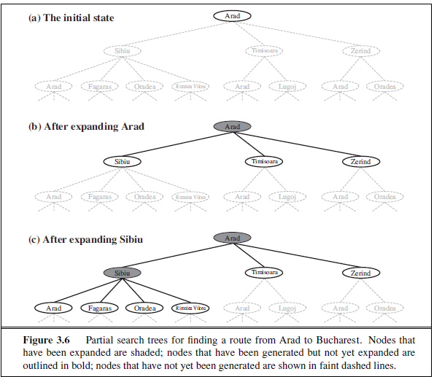

Slide 66
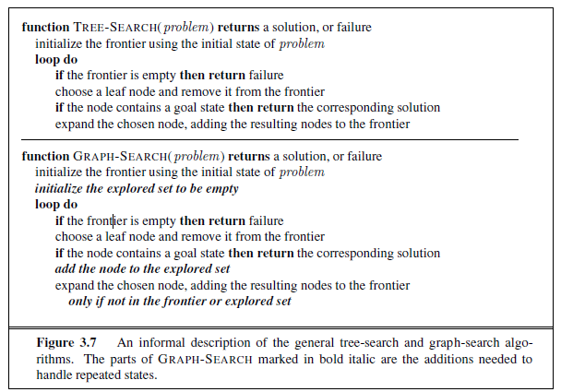

Slide 67
Search algorithms all share this basic structure; they vary primarily according to how they choose which state to expand next—the so-called search strategy.
The eagle-eyed reader will notice one peculiar thing about the search tree shown in Fig3.6: it includes the path from Arad to Sibiu and back to Arad again! In(Arad) is a repeated state in the search tree, generated in this case by a loopy path.
Considering such loopy paths means that the complete search tree for Romania is infinite because there is no limit to how often one can traverse a loop.
The state space—the map shown in Fig3.2 has only 20 states.
Loops can cause certain algorithms to fail, making otherwise solvable problems unsolvable. No need to consider loopy paths.
Path costs are additive and step costs are nonnegative, a loopy path to any given state is never better than the same path with the loop removed.

Slide 68
Loopy paths are a special case of the more general concept of redundant paths, which exist whenever there is more than one way to get from one state to another.
Consider the paths Arad–Sibiu (140 km long) and Arad–Zerind–Oradea–Sibiu (297 km long).
Second path is redundant—it’s just a worse way to get to the same state.
If you are concerned about reaching the goal, there’s never any reason to keep more than one path to any given state, because any goal state that is reachable by extending one path is also reachable by extending the other.
It is possible to define the problem itself so as to eliminate redundant paths.
Ex: If we formulate the 8-queens problem so that a queen can be placed in any column, then each state with n queens can be reached by n! different paths; but if we reformulate the problem so that each new queen is placed in the leftmost empty column, then each state can be reached only through one path.

Slide 69
This includes all problems where the actions are reversible, such as route-finding problems and sliding-block puzzles.
Route finding on a rectangular grid (like the one used later for Figure 3.9) is a particularly important example in computer games.
In a grid, each state has four successors, so a search tree of depth d that includes repeated states has 4^{d} leaves; but there are only about 2d² distinct states within d steps of any given state.
For d = 20, means about a trillion nodes but only about 800 distinct states.
Following redundant paths can cause a tractable problem to become intractable.
This is true even for algorithms that know how to avoid infinite loops.

Slide 70
Algorithms that forget their history are doomed to repeat it.
The way to avoid exploring redundant paths is to remember where one has been.
To do this, augment the TREE-SEARCH algorithm with a data structure called the explored set (also known as the closed list), which remembers every expanded node.
Newly generated nodes that match previously generated nodes—ones in the explored set or the frontier—can be discarded instead of being added to the frontier.
New algorithm, called GRAPH-SEARCH, is shown informally in Fig3.7.
The search tree constructed by the GRAPH-SEARCH algorithm contains at most one copy of each state, so we can think of it as growing a tree directly on the state-space graph, as shown in Fig3.8.
The algorithm has another nice property: the frontier separates the state-space graph into the explored region and the unexplored region, so that every path from the initial state to an unexplored state has to pass through a state in the frontier.

Slide 71
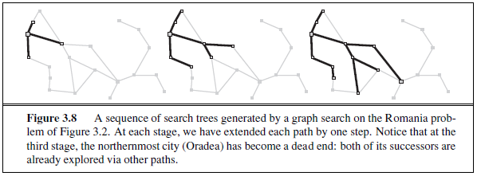
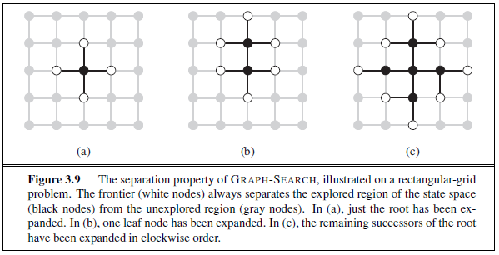

Slide 72
This property is illustrated in Figure 3.9.
As every step moves a state from the frontier into the explored region while moving some states from the unexplored region into the frontier.
Algorithm is systematically examining the states in the state space, one by one, until it finds a solution
INFRASTRUCTURE FOR SEARCH ALGORITHMS
Search algorithms require a data structure to keep track of the search tree that is being constructed.
For each node n of the tree, we have a structure that contains four components:
• n.STATE: the state in the state space to which the node corresponds;
• n.PARENT: the node in the search tree that generated this node;
• n.ACTION: the action that was applied to the parent to generate the node;

Slide 73
UNINFORMED SEARCH STRATEGIES
Several search strategies that come under the heading of uninformed search (also called blind search).
The term means that the strategies have no additional information about states beyond that provided in the problem definition.
All they can do is generate successors and distinguish a goal state from a non-goal state.
All search strategies are distinguished by the order in which nodes are expanded.
Strategies that know whether one non-goal state is “more promising” than another are called informed search or heuristic search strategies;
Breadth-First, Uniform-Cost, Depth-First, Depth-Limited, Iterative Deepening, Bidirectional

Slide 74
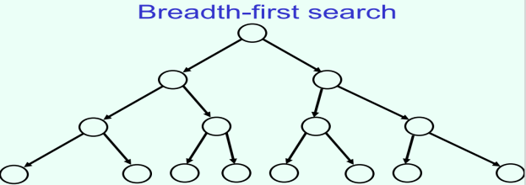
BREADTH FIRST SEARCH
It is a simple strategy in which the root node is expanded first, then all the successors of the root node are expanded next, then their successors, and so on.
All the nodes are expanded at a given depth in the search tree before any nodes at the next level are expanded.
Breadth-first search is an instance of the general graph-search algorithm in which the shallowest unexpanded node is chosen for expansion.
This is achieved very simply by using a FIFO queue for the frontier.
Thus, new nodes (which are always deeper than their parents) go to the back of the queue, and old nodes, which are shallower than the new nodes, get expanded first.
There is one slight tweak on the general graph-search algorithm, which is that the goal test is applied to each node when it is generated rather than when it is selected for expansion.
Algorithm, following the general template for graph search, discards any new path to a state already in the frontier or explored set;
It is easy to see that any such path must be at least as deep as the one already found.
Thus, breadth-first search always has the shallowest path to every node on the frontier

Slide 75
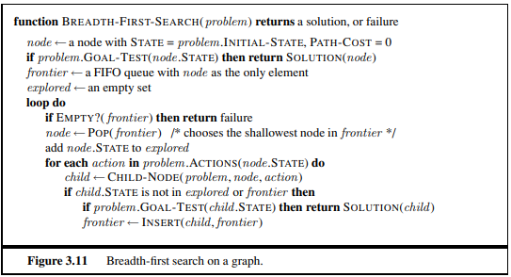
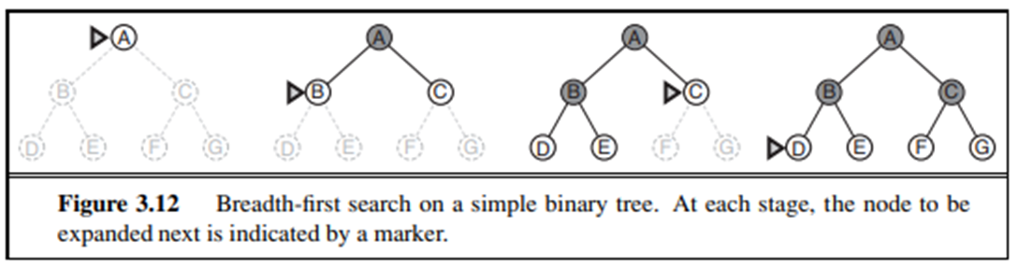
Pseudocode is given in Figure 3.11.
Figure 3.12 shows the progress of the search on a simple binary tree.
BFS is complete—if the shallowest goal node is at some finite depth d, breadth-first search will eventually find it after generating all shallower nodes (provided the branching factor b is finite).
As soon as a goal node is generated, and know that it is the shallowest goal node because all shallower nodes must have been generated already and failed the goal test.
Shallowest goal node is not necessarily the optimal one;
Technically, BFS is optimal if the path cost is a non-decreasing function of the depth of the node.
The news about time and space is not so good. Imagine searching a uniform tree where every state has b successors.
The root of the search tree generates b nodes at the first level, each of which generates b more nodes, for a total of b² at the second level.

Slide 76
The most common such scenario is that all actions have the same cost.
Each of these generates b more nodes, yielding b³ nodes at the third level, and so on.
Suppose that the solution is at depth d. In the worst case, it is the last node generated at that level.
Total number of nodes generated is b + b² + b³ + ··· + b^{d} = O(b^{d}) (If the algorithm were to apply the goal test to nodes when selected for expansion, rather than when generated, the whole layer of nodes at depth d would be expanded before the goal was detected and the time complexity would be O(b^{d+1}).)
Space complexity: for any kind of graph search, which stores every expanded node in the explored set, the space complexity is always within a factor of b of the time complexity.
For breadth-first graph search in particular, every node generated remains in memory.
There will be O(b^{d−1}) nodes in the explored set and O(b^{d}) nodes in the frontier
so the space complexity is O(b^{d}), i.e., it is dominated by the size of the frontier.
Switching to a tree search would not save much space, and in a state space with many redundant paths, switching could cost a great deal of time.
An exponential complexity bound such as O(b^{d}) is scary.

Slide 77
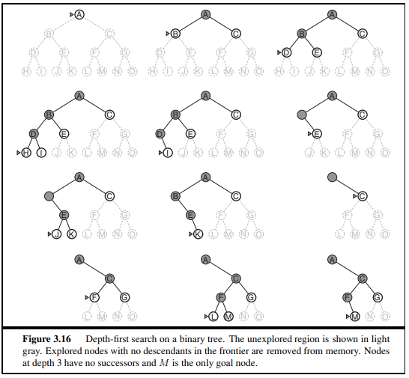
DEPTH FIRST SERCH
Depth-first search always expands the deepest node in the current frontier of the search tree.
The progress of the search is illustrated in Figure 3.16.
The search proceeds immediately to the deepest level of the search tree, where the nodes have no successors.
As those nodes are expanded, they are dropped from the frontier, so then the search “backs up” to the next deepest node that still has unexplored successors.
The depth-first search algorithm is an instance of the graph-search algorithm whereas breadth-first-search uses a FIFO queue, depth-first search uses a LIFO queue.
A LIFO queue means that the most recently generated node is chosen for expansion.
This must be the deepest unexpanded node because it is one deeper than its parent—which, in turn, was the deepest unexpanded node when it was selected.

Slide 78
As an alternative to the GRAPH-SEARCH-style implementation, it is common to implement depth-first search with a recursive function that calls itself on each of its children in turn.
(A recursive depth-first algorithm incorporating a depth limit is shown in Figure 3.17.)
The properties of depth-first search depend strongly on whether the graph-search or tree-search version is used.
The graph-search version, which avoids repeated states and redundant paths, is complete in finite state spaces because it will eventually expand every node.
The tree-search version, on the other hand, is not complete—for example, in Figure 3.6 the algorithm will follow the Arad–Sibiu–Arad–Sibiu loop forever.
Depth-first tree search can be modified at no extra memory cost so that it checks new states against those on the path from the root to the current node; this avoids infinite loops in finite state spaces but does not avoid the proliferation of redundant paths.
In infinite state spaces, both versions fail if an infinite non-goal path is encountered.
For example, in Knuth’s 4 problem, depth-first search would keep applying the factorial operator forever

Slide 79
For similar reasons, both versions are non-optimal.
For example, in Figure 3.16, depth first search will explore the entire left subtree even if node C is a goal node.
If node J were also a goal node, then depth-first search would return it as a solution instead of C, which would be a better solution; hence, depth-first search is not optimal.
The time complexity of depth-first graph search is bounded by the size of the state space (which may be infinite, of course).
A depth-first tree search, on the other hand, may generate all of the O(b^{m}) nodes in the search tree, where m is the maximum depth of any node; this can be much greater than the size of the state space.
Note that m itself can be much larger than d (the depth of the shallowest solution) and is infinite if the tree is unbounded.
DFS seems to have advantage over breadth-first search in terms of space complexity.
For a graph search, there is no advantage, but a depth-first tree search needs to store only a single path from the root to a leaf node, along with the remaining unexpanded sibling nodes for each node on the path.
Once a node has been expanded, it can be removed from memory as soon as all its descendants have been fully explored. (See Figure 3.16.)
For a state space with branching factor b and maximum depth m, depth-first search requires storage of only O(bm) nodes.

Slide 80
A variant of depth-first search called backtracking search uses still less memory.
In backtracking, only one successor is generated at a time rather than all successors; each partially expanded node remembers which successor to generate next.
Only O(m) memory is needed rather than O(bm).
Backtracking search facilitates yet another memory-saving (and time-saving) trick: the idea of generating a successor by modifying the current state description directly rather than copying it first.
This reduces the memory requirements to just one state description and O(m) actions.
For this to work, we must be able to undo each modification when we go back to generate the next successor.
For problems with large state descriptions, such as robotic assembly, these techniques are critical to success.

Slide 81
HILL CLIMBING
BEYOND CLASSICAL SEARCH
LOCAL SEARCH ALGORITHMS AND OPTIMIZATION PROBLEMS
The search algorithms that we have seen so far are designed to explore search spaces systematically.
This systematicity is achieved by keeping one or more paths in memory and by recording which alternatives have been explored at each point along the path.
When a goal is found, the path to that goal also constitutes a solution to the problem.
In many problems, however, the path to the goal is irrelevant.
Hill-climbing search
The hill-climbing search algorithm (steepest-ascent version) is shown in Figure 4.2.
It is STEEPEST ASCENT simply a loop that continually moves in the direction of increasing value—that is, uphill.
It terminates when it reaches a “peak” where no neighbor has a higher value.
The algorithm does not maintain a search tree, so the data structure for the current node need only record the state and the value of the objective function.
Hill climbing does not look ahead beyond the immediate neighbors of the current state.
This resembles trying to find the top of Mount Everest in a thick fog while suffering from amnesia.

Slide 82
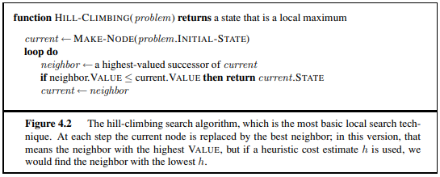
To illustrate hill climbing, we will use the 8-queens problem introduced on page 71.
Local search algorithms typically use a complete-state formulation, where each state has 8 queens on the board, one per column.
The successors of a state are all possible states generated by moving a single queen to another square in the same column (so each state has 8 × 7 = 56 successors).
The heuristic cost function h is the number of pairs of queens that are attacking each other, either directly or indirectly.
The global minimum of this function is zero, which occurs only at perfect solutions.
Figure 4.3(a) shows a state with h = 17.
The figure also shows the values of all its successors, with the best successors having h = 12.
Hill-climbing algorithms typically choose randomly among the set of best successors if there is more than one.
Hill climbing is sometimes called greedy local search because it grabs a good neighbor state without thinking ahead about where to go next.
Although greed is considered one of the seven deadly sins, it turns out that greedy algorithms often perform quite well.

Slide 83
Hill climbing often makes rapid progress toward a solution because it is usually quite easy to improve a bad state.
Ex: From the state in Figure 4.3(a), it takes just five steps to reach the state in Figure 4.3(b), which has h = 1 and is very nearly a solution.
Unfortunately, hill climbing often gets stuck for the following reasons:
Local maxima: a local maximum is a peak that is higher than each of its neighboring states but lower than the global maximum.
Hill-climbing algorithms that reach the vicinity of a local maximum will be drawn upward toward the peak but will then be stuck with nowhere else to go.
Figure 4.1 illustrates the problem schematically.
More concretely, the state in Figure 4.3(b) is a local maximum (i.e., a local minimum for the cost h); every move of a single queen makes the situation worse.
• Ridges: a ridge is shown in Figure 4.4. Ridges result in a sequence of local maxima
that is very difficult for greedy algorithms to navigate.
• Plateaux: a plateau is a flat area of the state-space landscape. It can be a flat local
maximum, from which no uphill exit exists, or a shoulder, from which progress is
possible. (See Figure 4.1.) A hill-climbing search might get lost on the plateau
In each case, the algorithm reaches a point at which no progress is being made.
Starting from a randomly generated 8-queens state, steepest-ascent hill climbing gets stuck 86% of the time, solving only 14% of problem instances.
It works quickly, taking just 4 steps on average when it succeeds and 3 when it gets stuck—not bad for a state space with 88 ≈ 17 million states.

Slide 84
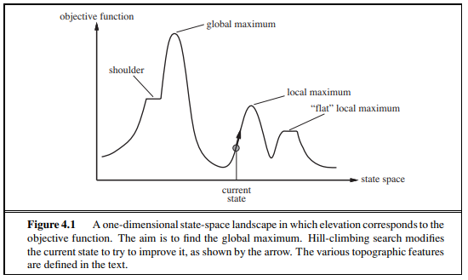
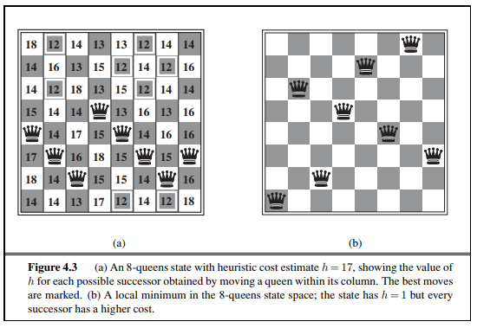
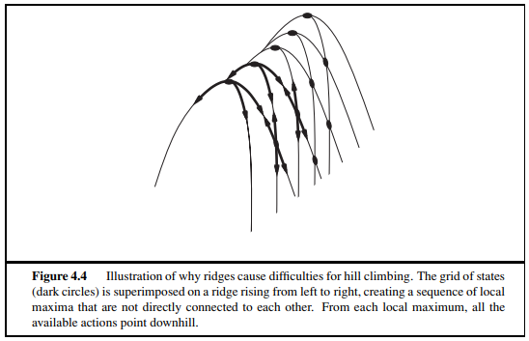
The algorithm in Figure 4.2 halts if it reaches a plateau where the best successor has the same value as the current state.
Might it not be a good idea to keep going—to allow a sideways move in the hope that the plateau is really a shoulder, as shown in Figure 4.1?
The answer is usually yes, but we must take care. If we always allow sideways moves when there are no uphill moves, an infinite loop will occur whenever the algorithm reaches a flat local maximum that is not a shoulder.
One common solution is to put a limit on the number of consecutive sideways moves allowed.
Ex: Allow up to, say, 100 consecutive sideways moves in the 8-queens problem. This raises the percentage of problem instances solved by hill climbing from 14% to 94%.
Success comes at a cost: the algorithm averages roughly 21 steps for each successful instance and 64 for each failure.

Slide 85
Simulated annealing
A hill-climbing algorithm that never makes “downhill” moves toward states with lower value (or higher cost) is guaranteed to be incomplete, because it can get stuck on a local maximum.
In contrast, a purely random walk—that is, moving to a successor chosen uniformly at random from the set of successors—is complete but extremely inefficient.
Therefore, it seems reasonable to try to combine hill climbing with a random walk in some way that yields both efficiency and completeness.
Simulated annealing is such an algorithm.
In metallurgy, annealing is the process used to temper or harden metals and glass by heating them to a high temperature and then gradually cooling them, thus allowing the material to reach a low energy crystalline state.
To explain simulated annealing, we switch our point of view from hill climbing to gradient descent (i.e., minimizing cost) and imagine the task of getting a ping-pong ball into the deepest crevice in a bumpy surface.

Slide 86
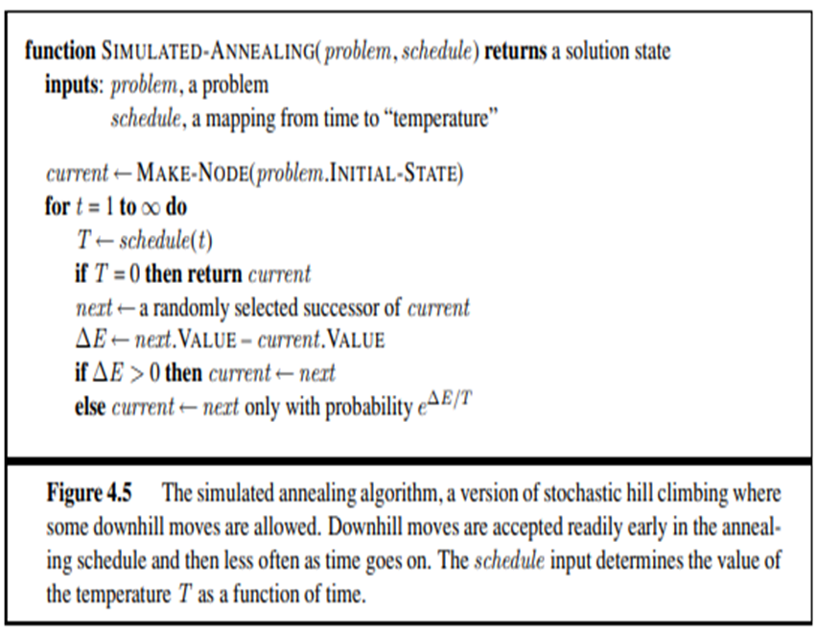
If we just let the ball roll, it will come to rest at a local minimum.
If we shake the surface, we can bounce the ball out of the local minimum.
The trick is to shake just hard enough to bounce the ball out of local minima but not hard enough to dislodge it from the global minimum.
The simulated-annealing solution is to start by shaking hard (i.e., at a high temperature) and then gradually reduce the intensity of the shaking (i.e., lower the temperature).
The innermost loop of the simulated-annealing algorithm (Figure 4.5) is quite similar to hill climbing.

Slide 87
Instead of picking the best move, however, it picks a random move.
If the move improves the situation, it is always accepted. Otherwise, the algorithm accepts the move with some probability less than 1.
The probability decreases exponentially with the “badness” of the move—the amount ΔE by which the evaluation is worsened.
The probability also decreases as the “temperature” T goes down: “bad” moves are more likely to be allowed at the start when T is high, and they become more unlikely as T decreases.
If the schedule lowers T slowly enough, the algorithm will find a global optimum with probability approaching 1

Slide 88
LOCAL SEARCH IN CONTINUOUS SPACE
Explained the distinction between discrete and continuous environments, pointing out that most real-world environments are continuous.
Yet none of the algorithms we have described (except for first-choice hill climbing and simulated annealing) can handle continuous state and action spaces, because they have infinite branching factors.
This section provides a very brief introduction to some local search techniques for finding optimal solutions in continuous spaces.
The literature on this topic is vast; many of the basic techniques originated in the 17th century, after the development of calculus by Newton and Leibniz.6
We find uses for these techniques at several places in the book, including the chapters on learning, vision, and robotics.
Ex: Suppose we want to place three new airports anywhere in Romania, such that the sum of squared distances from each city on the map (Figure 3.2) to its nearest airport is minimized.
The state space is then defined by the coordinates of the airports: (x1, y1), (x2, y2), and (x3, y3).
This is a six-dimensional space; we also say that states are defined by six variables. (In general, states are defined by an n-dimensional vector of variables, x.)
Moving around in this space corresponds to moving one or more of the airports on the map.
The objective function f(x1, y1, x2, y2, x3, y3) is relatively easy to compute for any particular state once we compute the closest cities.

Slide 89
Let Ci be the set of cities whose closest airport (in the current state) is airport i.
Then, in the neighborhood of the current state, where the Cis remain constant, we have
This expression is correct locally, but not globally because the sets Ci are (discontinuous) functions of the state.
One way to avoid continuous problems is simply to discretize the neighborhood of each state.
Ex: Move only one airport at a time in either the x or y direction by a fixed amount ±δ.
With 6 variables, this gives 12 possible successors for each state.
We can then apply any of the local search algorithms described previously.
We could also apply stochastic hill climbing and simulated annealing directly, without discretizing the space.
These algorithms choose successors randomly, which can be done by generating random vectors of length δ

Slide 90


Many methods attempt to use the gradient of the landscape to find a maximum.
The gradient of the objective function is a vector ∇f that gives the magnitude and direction of the steepest slope.
For our problem, we have
In some cases, we can find a maximum by solving the equation ∇f = 0. (This could be done, Ex: if we were placing just one airport; the solution is the arithmetic mean of all the cities’ coordinates.)
This equation cannot be solved in closed form.
Ex: with three airports, the expression for the gradient depends on what cities are closest to each airport in the current state.
This means we can compute the gradient locally (but not globally); for example,
(4.2)
Given a locally correct expression for the gradient, we can perform steepest-ascent hill climbing by updating the current state according to the formula

Slide 91
where α is a small constant often called the step size.
In other cases, the objective function might not be available in a differentiable form at all—for example, the value of a particular set of airport locations might be determined by running some large-scale economic simulation package.
In those cases, we can calculate a so-called empirical gradient by evaluating the response to small increments and decrements in each coordinate.
Empirical gradient search is the same as steepest-ascent hill climbing in a discretized version of the state space.
Hidden beneath the phrase “α is a small constant” lies a huge variety of methods for adjusting α.
The basic problem is that, if α is too small, too many steps are needed; if α is too large, the search could overshoot the maximum.
The technique of line search tries to overcome this dilemma by extending the current gradient direction—usually by repeatedly doubling α—until f starts to decrease again.
The point at which this occurs becomes the new current state.
There are several schools of thought about how the new direction should be chosen at this point.

Slide 92
REFERENCES
Artificial Intelligence A Modern Approach, Third Edition, Stuart Russell and Peter Norvig, Pearson Education.
Vincent Conitzer, CPS 270: Artificial Intelligence http://www.cs.duke.edu/courses/fall08/cps270/

